Slide 1
Digital Portfolio
STUDENT NAME: Niranjan TS
REGISTER NO: 2428k0381 AND NMID: asbruaz2428k0381
DEPARTMENT: : B.Sc CS with Artificial Intelligence and Data Science
COLLEGE: COLLEGE/ UNIVERSITY

Slide 2
PROJECT TITLE
Two factor authentication demo

Slide 3


AGENDA
Problem Statement
Project Overview
End Users
Tools and Technologies
Portfolio design and Layout
Features and Functionality
Results and Screenshots
Conclusion
Github Link
3/21/2024 Annual Review

Slide 4

PROBLEM STATEMENT
In today’s digital landscape, traditional username and password authentication is no longer sufficient to ensure the security of user accounts. With increasing threats such as password leaks, phishing attacks, and unauthorized access, sensitive data is at constant risk. A single layer of authentication offers limited protection, especially when users choose weak or reused passwords.
To address this issue, there is a need for a more secure, reliable, and user-friendly authentication mechanism that can prevent unauthorized access even when the primary credentials are compromised.
This project aims to demonstrate the concept and workflow of Two-Factor Authentication (2FA) in a web application environment. The demo involves a two-step login process:

Slide 5

PROJECT OVERVIEW
This project demonstrates the implementation of a Two-Factor Authentication (2FA) system in a web application using HTML, CSS, and JavaScript. The purpose of this demo is to showcase how 2FA enhances login security by requiring users to provide two types of credentials: something they know (a username and password) and something they have (a one-time password or OTP).
In the first step, the user enters their username and password. Upon successful validation, the system generates a 6-digit OTP using JavaScript and displays it via a popup alert, simulating real-world OTP delivery (e.g., through email or SMS). The user must then input this OTP to complete the authentication process. If the OTP matches, access is granted; otherwise, an error message is displayed.
The user interface is designed to be colorful, responsive, and user-friendly, with clear feedback and visual cues to guide the user through the login process. While the demo runs entirely on the client side and uses static credentials for simplicity, it effectively illustrates the core logic of a real 2FA system.

Slide 6

WHO ARE THE END USERS?
1. Web Application Users
These are regular users who log in to web platforms such as email services, e-commerce sites, online banking portals, or cloud-based tools.
For them, 2FA adds an extra layer of security during login, helping protect their personal and sensitive information.
2. Administrators and IT Staff
System administrators and IT personnel responsible for managing platforms where security is critical (e.g., enterprise dashboards, control panels, CMS).
2FA ensures that administrative access is protected, reducing the risk of unauthorized configuration changes or data breaches.
3. Developers and Security Enthusiasts
Developers looking to learn or implement 2FA in their own applications can use this demo as a foundation.
Cybersecurity students or researchers can study the workflow and understand how 2FA adds security to traditional login systems.

Slide 7

TOOLS AND TECHNIQUES
HTML5
For creating the structure of the login and OTP verification forms.
CSS3
For styling the user interface with colorful themes and responsive layout.
JavaScript (ES6)
For implementing logic such as OTP generation, form validation, and UI interaction.
Visual Studio Code
Code editor used for writing and managing the source files.
Web Browser (e.g., Chrome, Firefox)
Used for running and testing the application in a real environment.

Slide 8
POTFOLIO DESIGN AND LAYOUT
The portfolio design for the Two-Factor Authentication (2FA) demo project follows a clean, modern, and visually appealing layout that effectively highlights the project’s key features and technical details. The project section begins with a clear title and a brief summary, providing visitors with a quick understanding of the demo’s purpose—enhancing login security by implementing a two-step verification process. Accompanying the summary is a vibrant screenshot or animated GIF showcasing the colorful and user-friendly interface of the login and OTP verification screens. The technology stack is presented using recognizable icons for HTML5, CSS3, and JavaScript to demonstrate the tools used. Key features such as OTP generation, form validation, and responsive design are outlined in concise bullet points, making it easy for viewers to grasp the project’s core functionalities. Interactive buttons link to a live demo and the GitHub repository, allowing users to explore and test the project firsthand. Additional sections provide the problem statement, tools and techniques employed, and future enhancement possibilities like backend integration or real OTP delivery. The overall design uses a harmonious color scheme matching the demo’s interface, with readable typography and ample whitespace to ensure clarity and focus. The layout adapts responsively across devices, ensuring an optimal experience whether viewed on desktop or mobile. This portfolio design not only showcases the technical skill behind the 2FA demo but also presents it in a professional, engaging format that appeals to potential employers, collaborators, or educators.
8

Slide 9
FEATURES AND FUNCTIONALITY
Two-Step Verification Process: Users first enter a username and password, then verify their identity by entering a one-time password (OTP).
OTP Generation: A random 6-digit OTP is generated dynamically using JavaScript for each successful login attempt.
Simulated OTP Delivery: The OTP is displayed in a popup alert, mimicking delivery via email or SMS.
OTP Validation: Users must enter the correct OTP to complete authentication; incorrect entries prompt error messages.
Form Validation: Both login and OTP input forms include validation to ensure fields are not left empty.

Slide 10
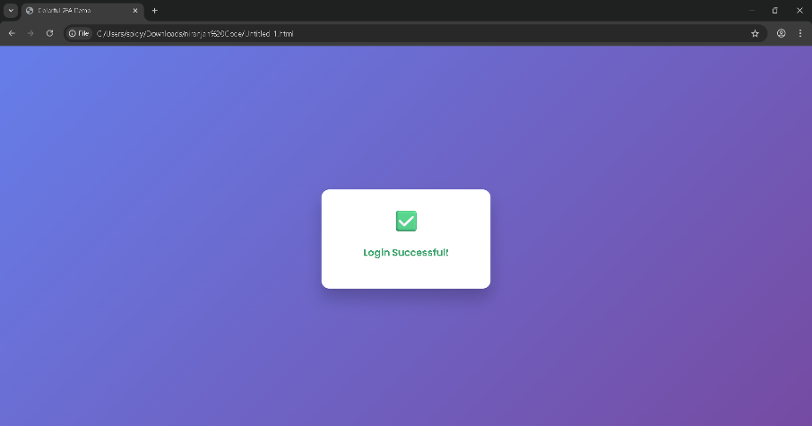

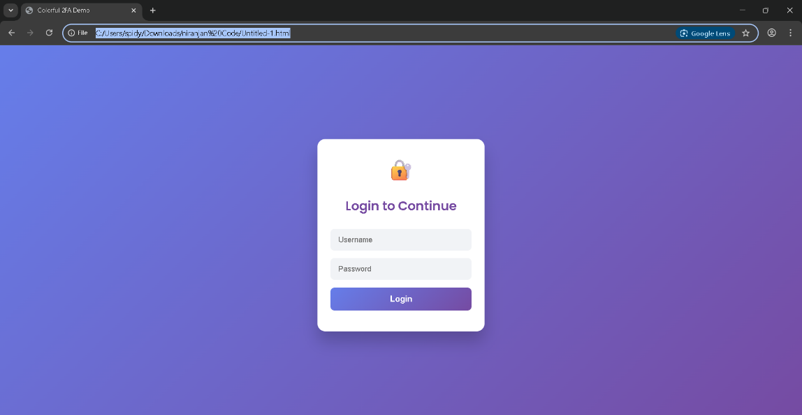
RESULTS AND SCREENSHOTS
3/21/2024 Annual Review
10

Slide 11
CONCLUSION
The Two-Factor Authentication (2FA) demo effectively demonstrates the importance and functionality of adding an extra layer of security to traditional login systems. By combining something the user knows (username and password) with something the user has (a one-time password), the demo highlights how 2FA significantly reduces the risk of unauthorized access even if primary credentials are compromised. Through a simple yet interactive interface, users experience the two-step verification process, including OTP generation and validation, providing a clear understanding of this essential security measure. While the demo operates entirely on the client side with simulated OTP delivery, it serves as a strong foundation for integrating more advanced features such as backend validation and real-time OTP delivery via email or SMS. Overall, this project reinforces the critical role of 2FA in modern web security and offers developers and learners a practical example to build upon for creating secure, user-friendly authentication systems.
11

